Slide 1

Computer Organization & Assembly language(CS-215T)
Lecture by:
Mr. Shakir Karim
Assistant Professor
DoCS&IT, SSUET
Batch 2022F

Slide 2
Week 11
Computer Memory Types & Hierarchy,
Cache Memory
Computer Science Department & Information Technology
Sir Syed University of Engg. & Tech.
Lecture by: Mr. Shakir Karim

Slide 3
Contents To Be Covered
Computer Memory Systems
Characteristics of Memory System
Why Computer Hierarchy?
Concept of Locality of Reference
Cache Memory and Element of Cache Design
Computer Science Department & Information Technology
Sir Syed University of Engg. & Tech.
Lecture by: Mr. Shakir Karim

Slide 4
Computer Memory System
Memory is
A logically structured – linear array of locations
Locations has addresses from 0 to maximum size a processor can address
Classification is based on distance from the processor
number of machine cycles required for access
Closer to processor, Faster the memory
Computer Science Department & Information Technology
Sir Syed University of Engg. & Tech.
Lecture by: Mr. Shakir Karim

Slide 5
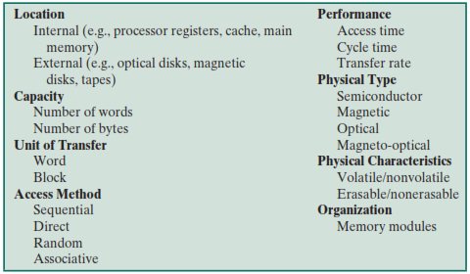
Characteristics Of Memory System
Computer Science Department & Information Technology
Sir Syed University of Engg. & Tech.
Lecture by: Mr. Shakir Karim

Slide 6
Memory Hierarchy
Solution
Why Hierarchy?
To cater for the trade-off among three characteristics
How much?
i.e., Capacity?
How Fast?
i.e., Access Time?
How Expensive?
i.e., Cost?
Possible trade-off relationships hold:
Access Time Cost per bit
Capacity Cost per bit
Capacity Access Time
Dilemma exists!
Computer Science Department & Information Technology
Sir Syed University of Engg. & Tech.
Lecture by: Mr. Shakir Karim

Slide 7
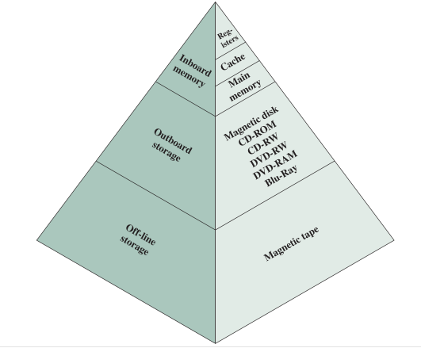
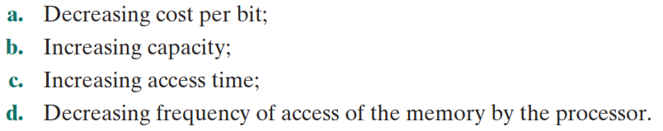
Memory Hierarchy
Important Item
Locality of Reference
Computer Science Department & Information Technology
Sir Syed University of Engg. & Tech.
Lecture by: Mr. Shakir Karim

Slide 8
Terms Related To Memory Hierarchy
Hit—requested data in a given level of memory (typically, only for upper levels of memory).
Miss—requested data not in given level of memory.
Hit rate—percentage of memory accesses found in a given level of memory.
Miss rate— (1 – Hit Rate)
Hit time—time required to access the requested information in a given level of memory
Miss penalty—time required to process a miss,
that includes replacing a block in an upper level of memory,
plus the additional time to deliver the requested data to the processor.
Computer Science Department & Information Technology
Sir Syed University of Engg. & Tech.
Lecture by: Mr. Shakir Karim

Slide 9
Locality Of Reference
If memory location X is accessed at time t,
(assuming no branch instructions)
there is a high probability that
memory location X + 1 will also be accessed in the near future.
This clustering of memory references into groups is an example of
Locality of Reference
Computer Science Department & Information Technology
Sir Syed University of Engg. & Tech.
Lecture by: Mr. Shakir Karim

Slide 10
Locality Of Reference – Types
Temporal locality
Recently accessed items tend to be accessed again in the near future.
Spatial locality
Accesses tend to be clustered in the address space
(for example, as in arrays or loops).
Sequential locality
Instructions tend to be accessed sequentially.
Computer Science Department & Information Technology
Sir Syed University of Engg. & Tech.
Lecture by: Mr. Shakir Karim

Slide 11
Locality Of Reference – Benefit
a small amount of very fast memory can be used to effectively accelerate the majority of memory accesses.
REASON:
only a small amount of the entire memory space is being accessed at any given time
values in that space are being accessed repeatedly.
∴values from a slower memory can be copied to a smaller but faster memory that resides higher in the hierarchy.
Computer Science Department & Information Technology
Sir Syed University of Engg. & Tech.
Lecture by: Mr. Shakir Karim

Slide 12
Locality Of Reference – Benefit
REASON:
only a small amount of the entire memory space is being accessed at any given time
values in that space are being accessed repeatedly.
∴values from a slower memory can be copied to a smaller but faster memory that resides higher in the hierarchy.
Results in a memory system that can store
A large amount of information in a large, low cost memory
yet provide nearly the same access speeds that would result from using very fast but expensive memory.
Computer Science Department & Information Technology
Sir Syed University of Engg. & Tech.
Lecture by: Mr. Shakir Karim

Slide 13
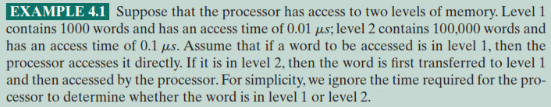
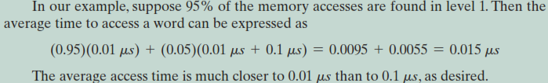
Locality Of Reference – Example
Computer Science Department & Information Technology
Sir Syed University of Engg. & Tech.
Lecture by: Mr. Shakir Karim

Slide 14
Cache Memory
Cache Memory is
a relatively small, fast memory
Interposed between a larger, slower memory and
the logic that accesses the larger memory.
holds recently accessed data
designed to speed up subsequent access to the same data.
combines memory access time of
expensive, high-speed memory with
the large memory size of
less expensive, lower-speed memory.
Computer Science Department & Information Technology
Sir Syed University of Engg. & Tech.
Lecture by: Mr. Shakir Karim

Slide 15
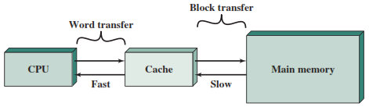
Cache Memory
Computer Science Department & Information Technology
Sir Syed University of Engg. & Tech.
Lecture by: Mr. Shakir Karim

Slide 16
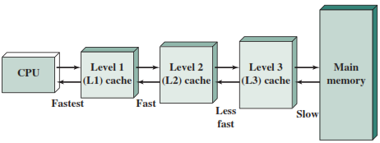
Cache Memory – Organization
Computer Science Department & Information Technology
Sir Syed University of Engg. & Tech.
Lecture by: Mr. Shakir Karim

Slide 17
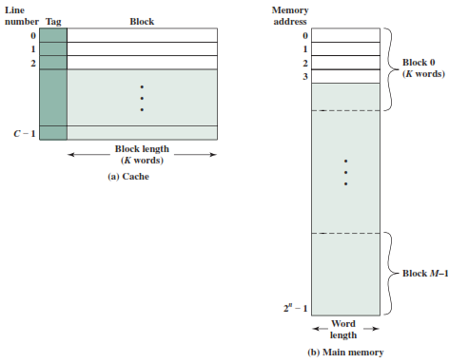
Cache Memory – Structure
C <<<M
Computer Science Department & Information Technology
Sir Syed University of Engg. & Tech.
Lecture by: Mr. Shakir Karim

Slide 18
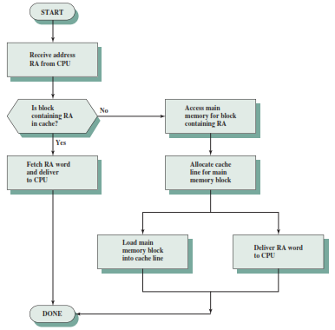
Cache Memory – Read Operation
Computer Science Department & Information Technology
Sir Syed University of Engg. & Tech.
Lecture by: Mr. Shakir Karim

Slide 19
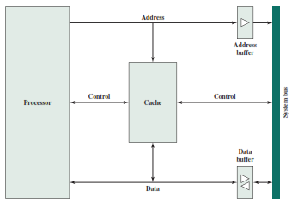
Cache Memory – Typical Organization
Computer Science Department & Information Technology
Sir Syed University of Engg. & Tech.
Lecture by: Mr. Shakir Karim

Slide 20
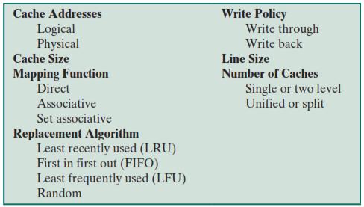
Elements Of Cache Design
Computer Science Department & Information Technology
Sir Syed University of Engg. & Tech.
Lecture by: Mr. Shakir Karim

Slide 21
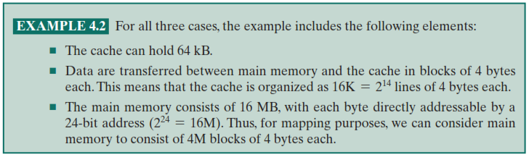
Elements Of Cache Design
Computer Science Department & Information Technology
Sir Syed University of Engg. & Tech.
Lecture by: Mr. Shakir Karim

